Slide 1
PIERCING & TATTOO WEBSITE DESIGN
Athanasios Ktenas
ITC4214

Slide 2
RED ACCENTS ON LIGHT AND DARK MODE

Slide 3
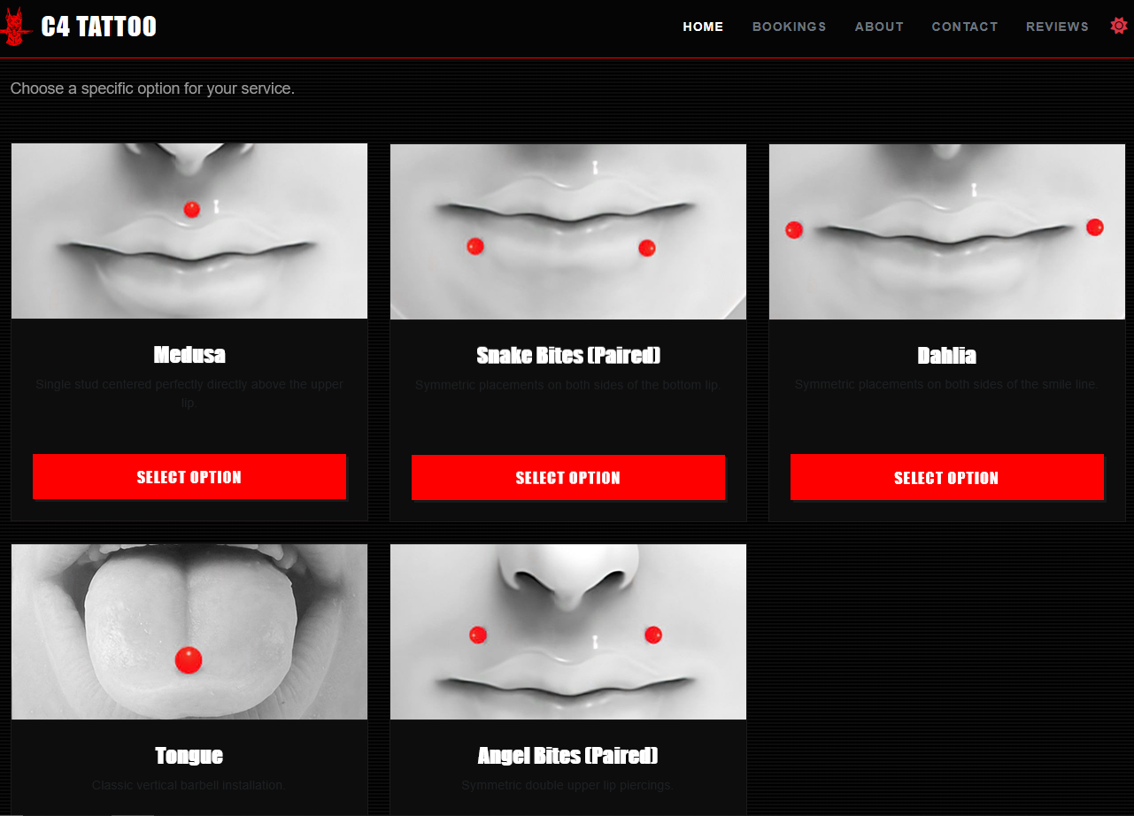
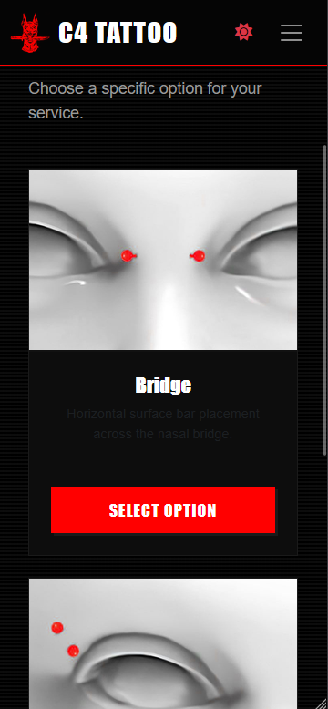

Slide 4
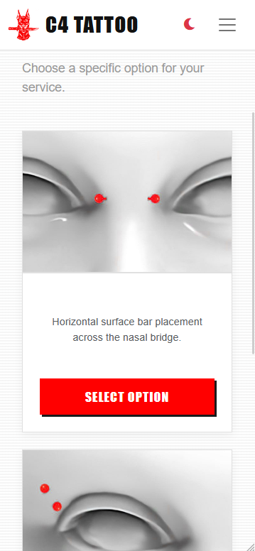
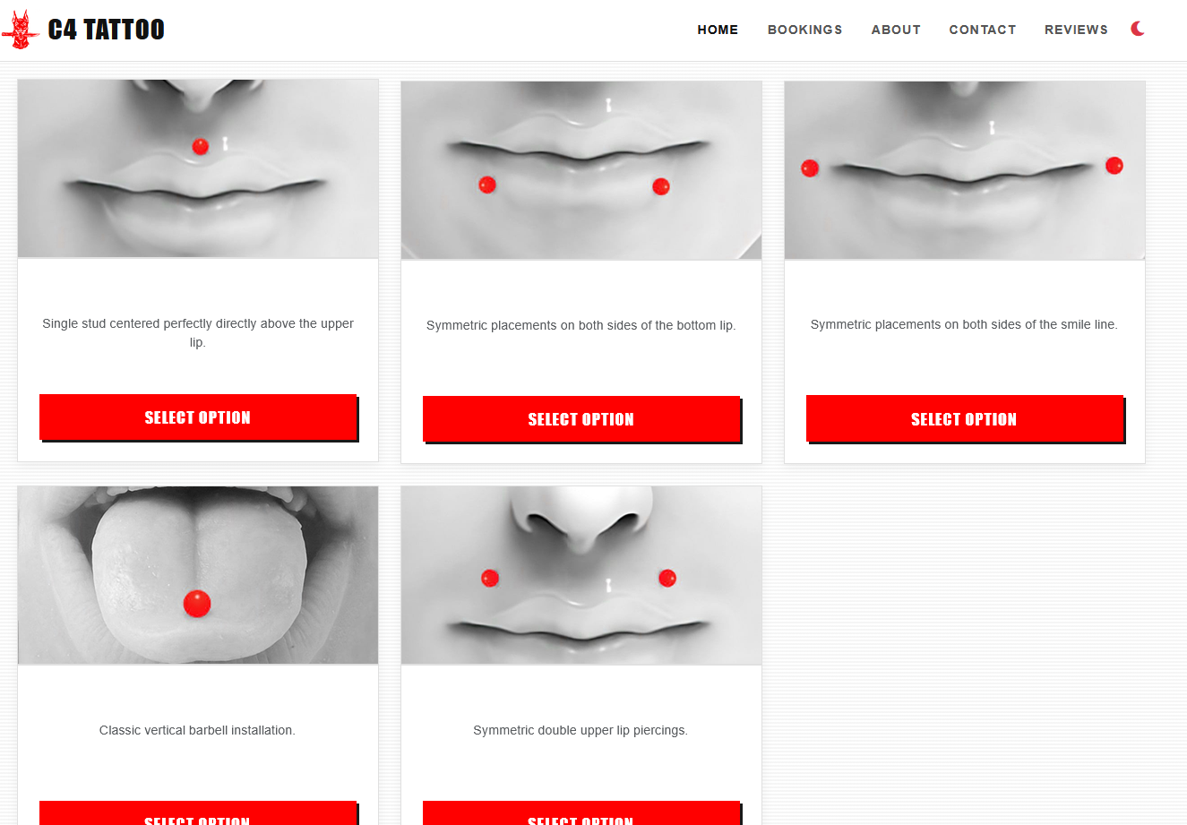

Slide 5
RESPONSIVE DESIGN

Slide 6
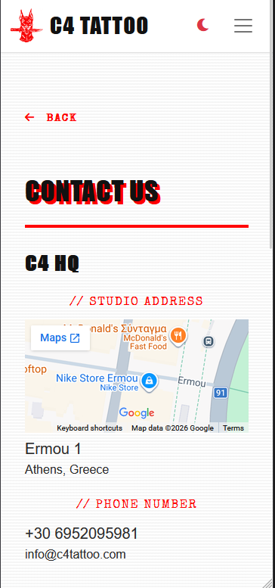
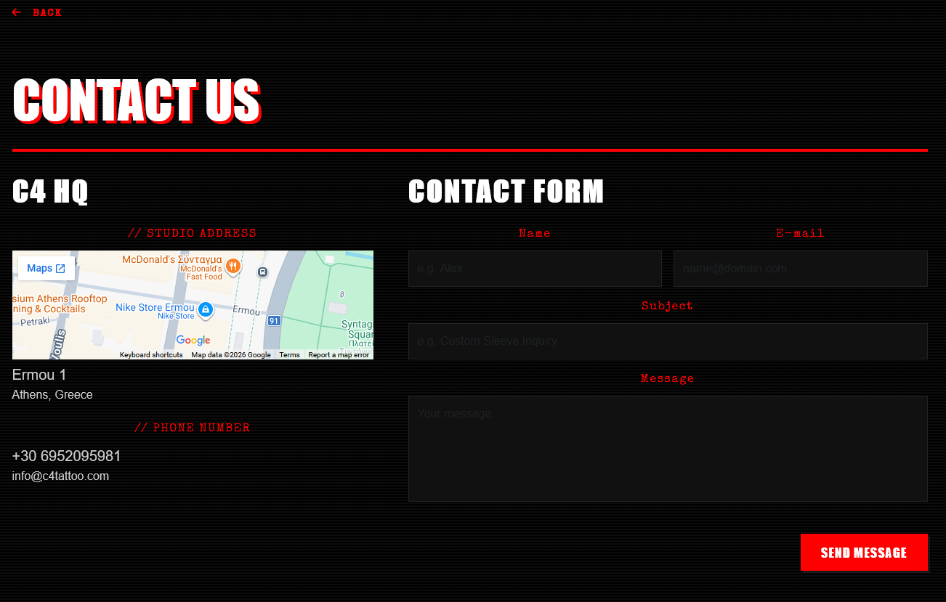

Slide 7
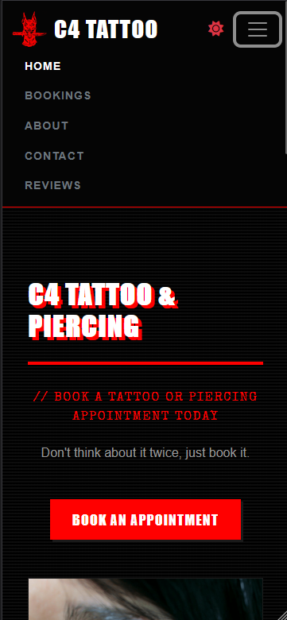
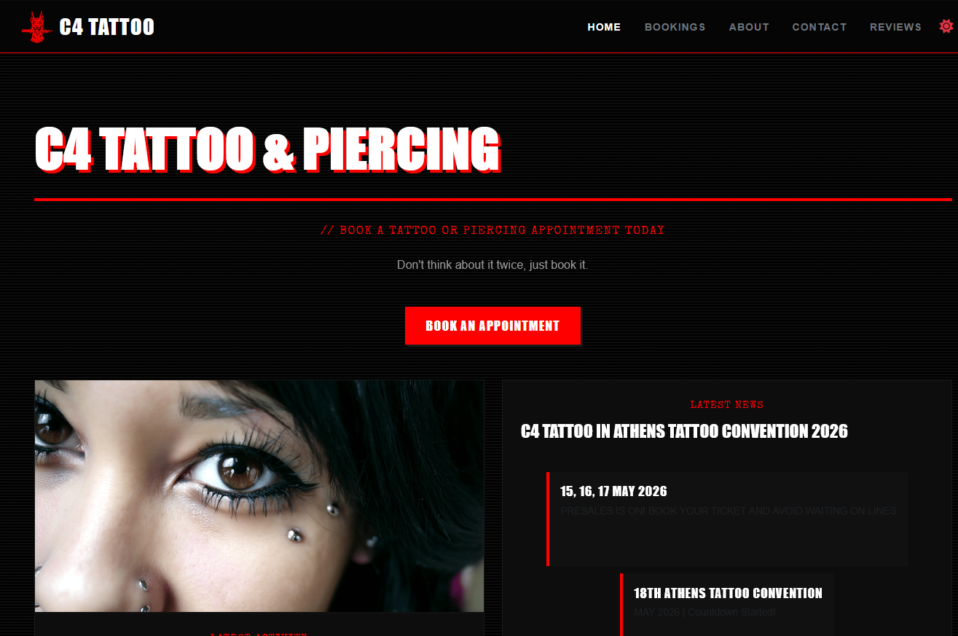

Slide 8
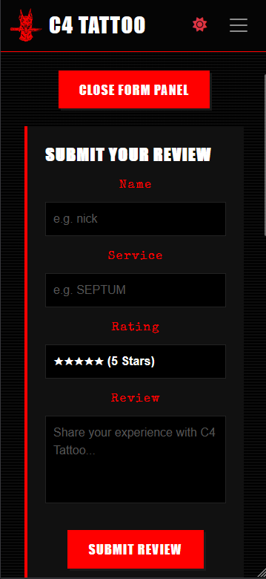
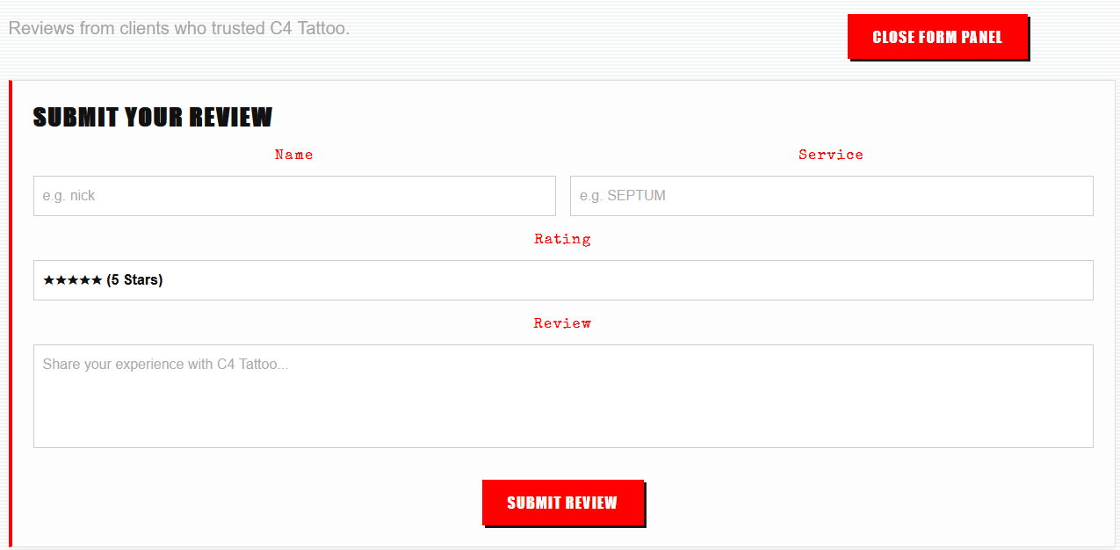

Slide 9
MOBILE vs DESKTOP VIEW BOOKING PROCESS STEPS

Slide 10
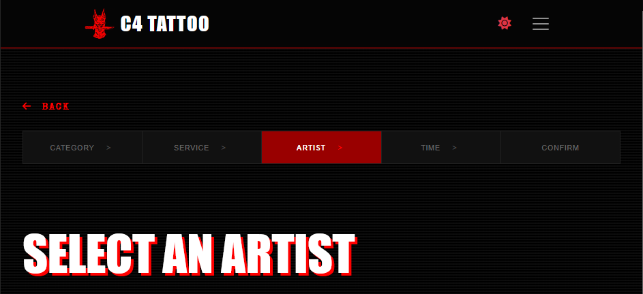

Slide 11
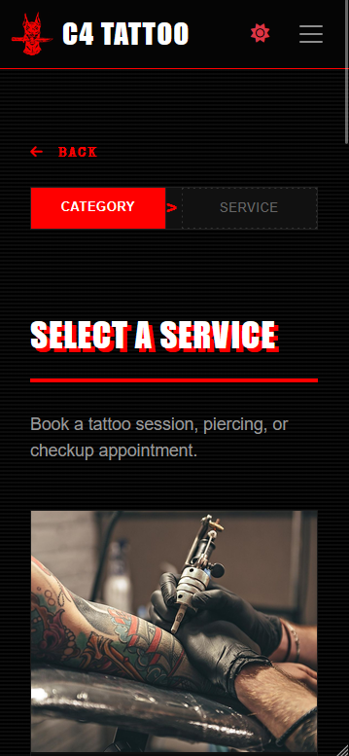
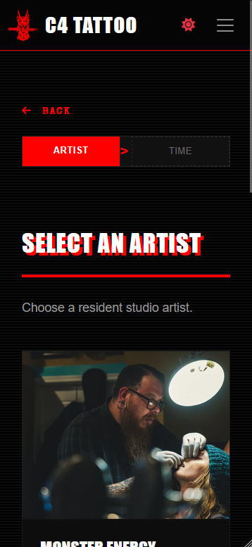
ONLY CURRENT AND NEXT STEP IS SHOWN

Slide 12
BURGER MENU ON DESKTOP & MOBILE

Slide 13
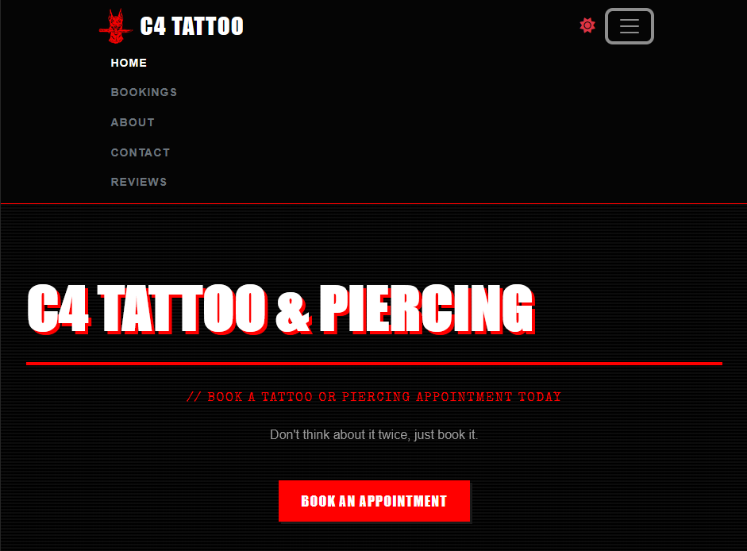

Slide 15
BOOKING SUMMARY TAB

Slide 16
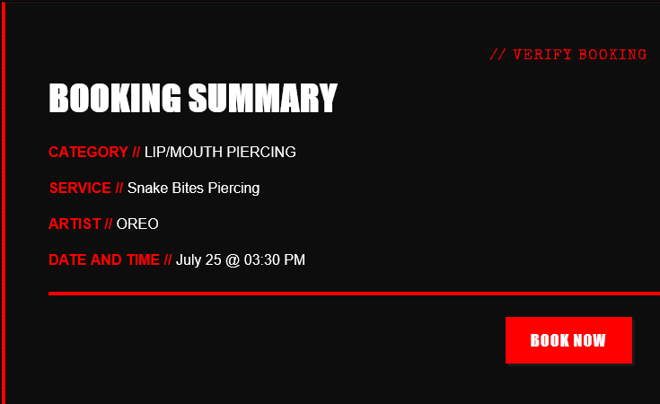

Slide 17
LIVE NOW
https://aktenas.pythonanywhere.com
[Staff Admin Account]
Username: admin
Password: 6afVmvEPQ+afWp
[Standard Customer Account]
Username: aktenas
Password: 0~jo1Oe4V|69

Slide 18
GITHUB REPOSITORY
https://github.com/aktenas/C4-Eshop

